Slide 1

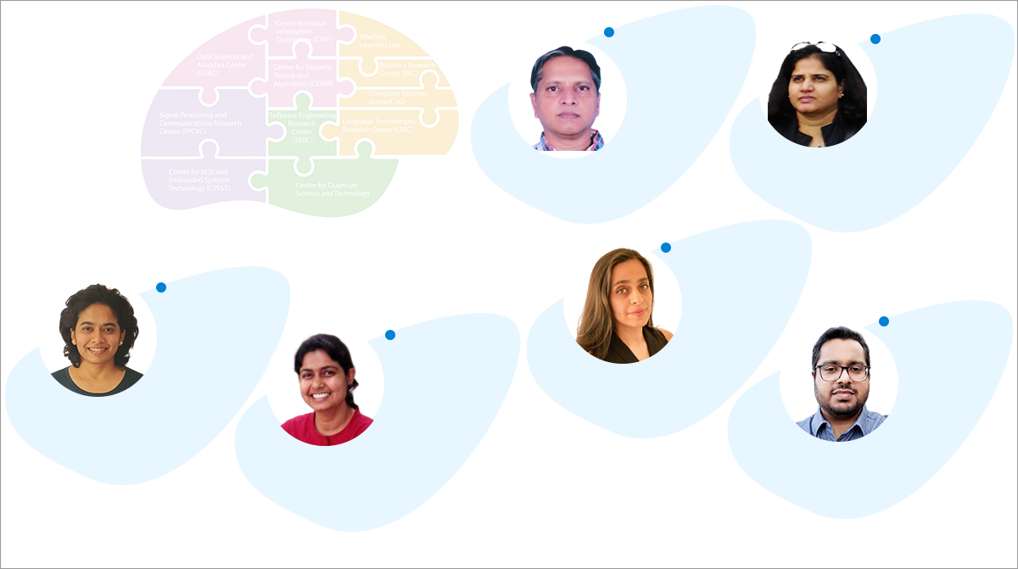
Time perception, AI, computational modelling
Empathy, neurorehab, neuroeconomics, game platforms
CogSci Lab
Bapi Raju
Professor, IIITH
Kavita Vemuri
Assistant Professor
IIITH
Music perception and social media, risk factors for depression
Stress, depression, memory & decision making, cognitive ageing
Memory, Lifelogging/
Extended Reality, Comp-Neurosci
cognitive risks for depression, virtual reality, eye-movement, and gait behaviour
Vinoo Alluri
Assistant Professor
IIITH
Bhaktee Dongaonkar
Assistant Professor
IIITH
Priyanka Srivastava
Senior Research Scientist
IIITH
Vishnu Sreekumar
Assistant Professor
IIITH

Slide 2
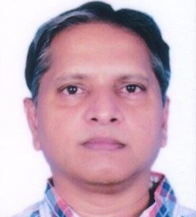
Brain, Cognition and Computation Lab (BCCL)
Computational Modeling:
Problems: Brain Development and Ageing; Structure-Function Mapping; Brain Encoding and Decoding; Disease Classification (Dementia, ASD, ADHD); Motor skill learning
Methods Employed: Connectomics (Graph/Network measures); Graph Spectral Harmonics; Graph CNN; Whole Brain Models; Oscillatory NN; (Deep) Reinforcement Learning; Cognitive Modeling
Empirical Investigation:
Problems: Motor Skill learning (Chunking, Inter-manual transfer); Time Perception (Subjective experience of time and influence of Number and Emotion); Agency
Methods Employed: Behavioral Expts; VR/AR based games/skills; EEG; fMRI (hopefully!)
Collaborators:
IIIT-H: Vinod; CCNSB; Avinash, CVIT; Manish Gupta (LTRC/Microsoft)
Outside: Srinivasa Chakravarthy, IIT-M; Dipanjan, IIT-J; Frederic & Nicolas (INRIA, Bordeaux)
Funding: DST CSRI; DST-Indo-French; UAY (TCS+ICMR)
Contact: Dr. S. Bapi Raju

Slide 3

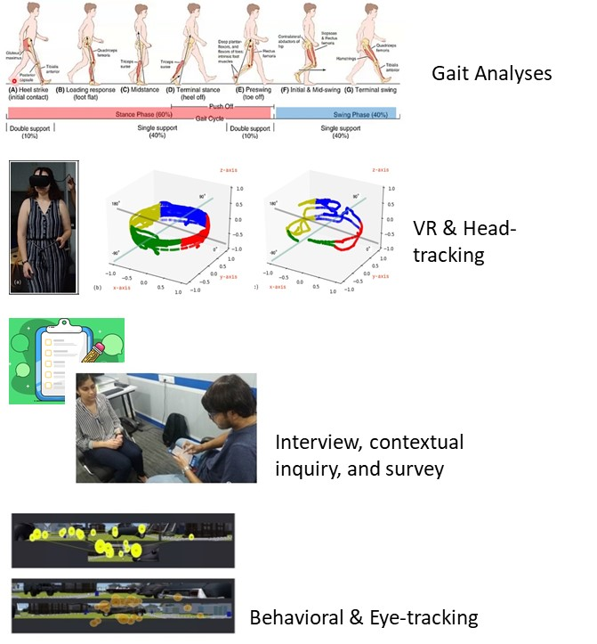
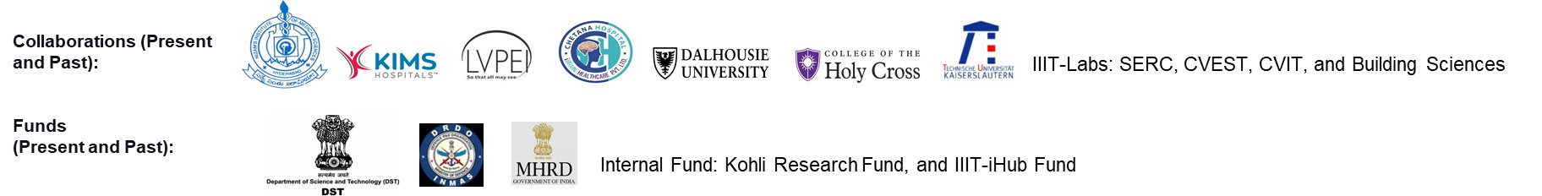
Perception and Cognition Lab (PAC)
Priyanka Srivastava
Theme 1: Depression and Cognition
Does depression influence 'general' or 'global' attentional processing or specific sub-domains of attentional network?
How does depression influence affective processing and representation and associated psychomotor responses, such as head movement, eye movement, and gait behavior?
Can characterizing general cognitive processes help identify cognitive-biological risk factors of depression in college-going young adults?
Can tuning attentional networks modulate depression-related cognitive biases and help develop better intervention or delay the onset of depression?
Theme 2: Systemic Lupus Erythematosus (SLE) or Lupus and Cognition
How does SLE influence general cognitive processing and mood?
How are SLE patients' psychosocial engagements related to global/general cognitive dysfunctions?
Method:

Slide 4
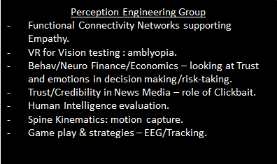
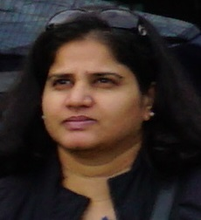
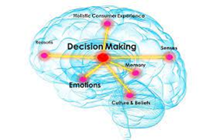
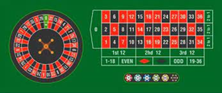
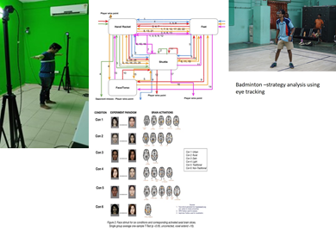
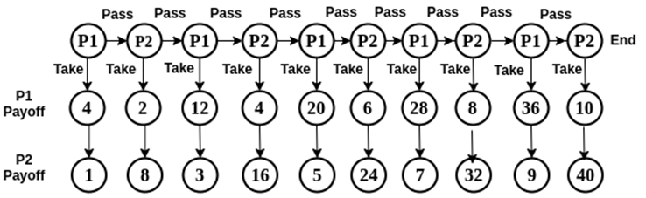
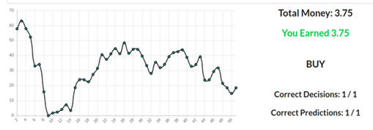
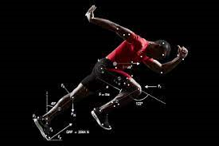

Kavita Vemuri

Slide 5
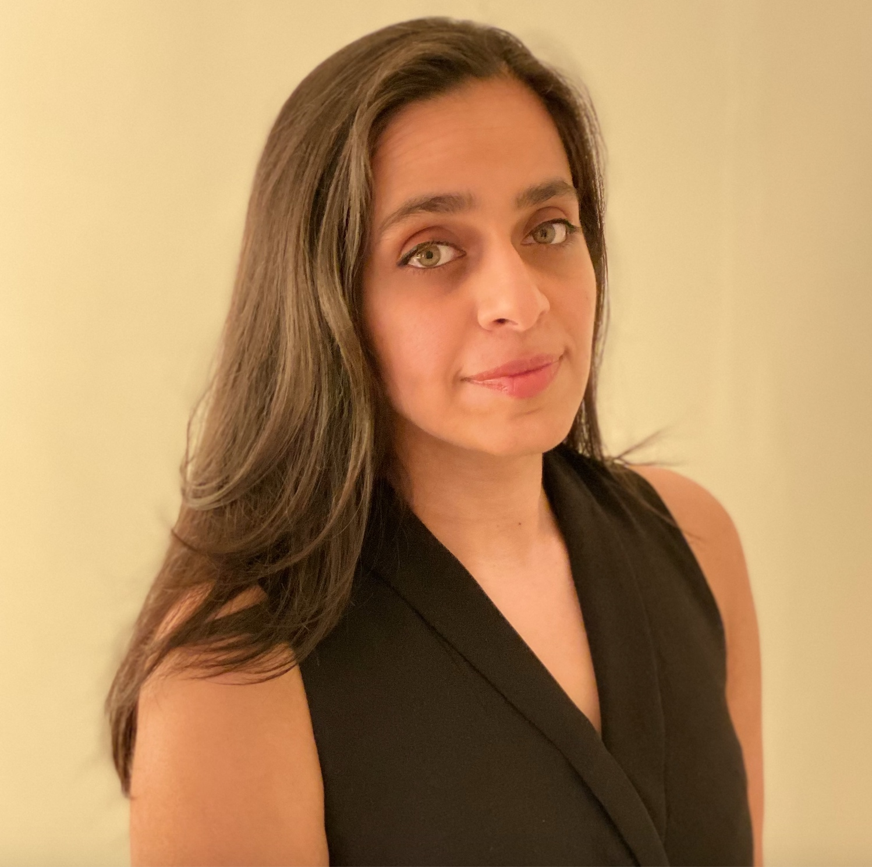
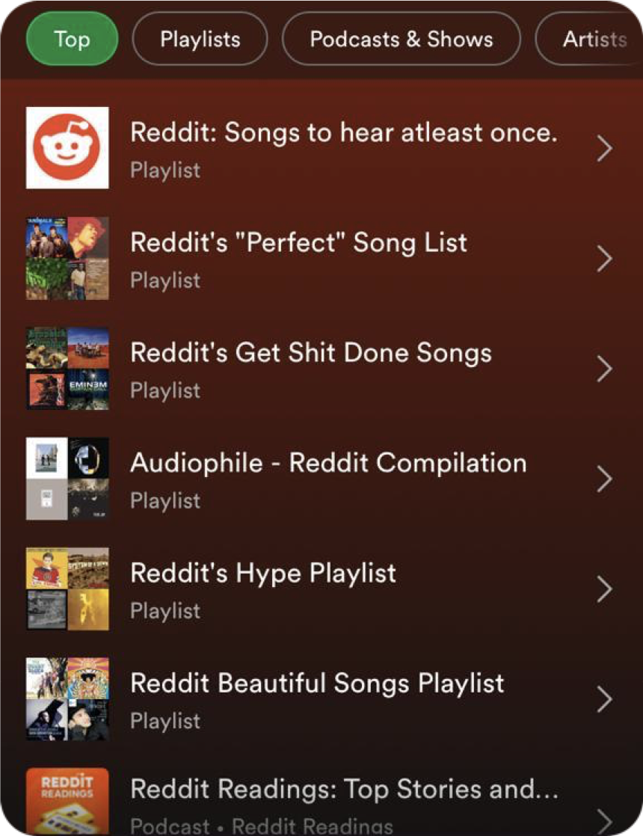
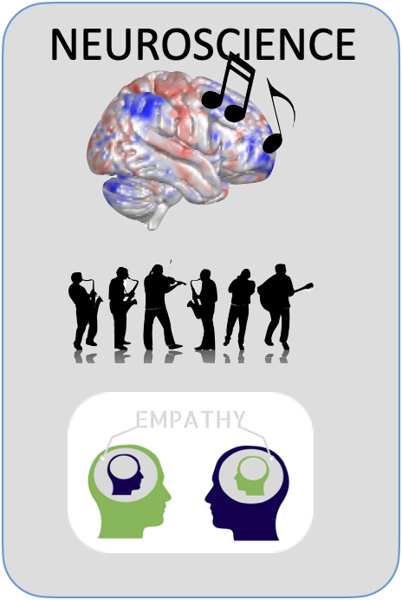
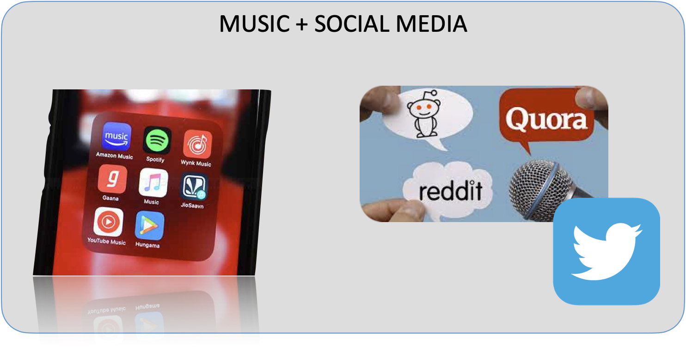
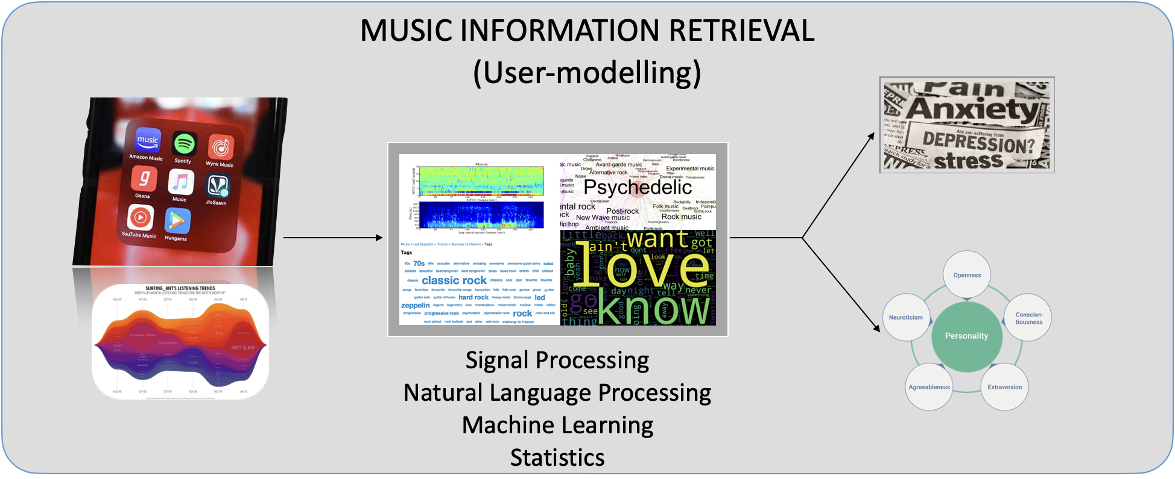

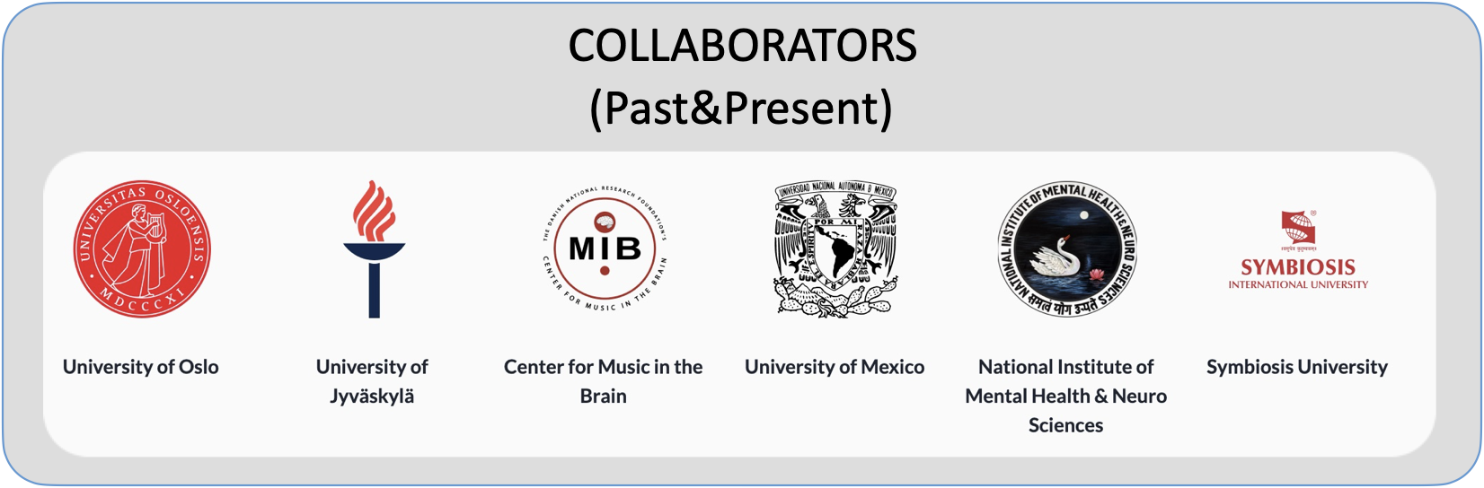
Music, Mind & Technology
how do our individual traits and states moderate our brain and behavioral responses to music?
can we predict risk of depression or any other disorders based on our musical choices?
does music serve different purposes in India when compared to non-Indian cultures?
what do discussions social-media based music sharing reveal?
how has popularity of certain artists changed across countries and time?

Slide 6
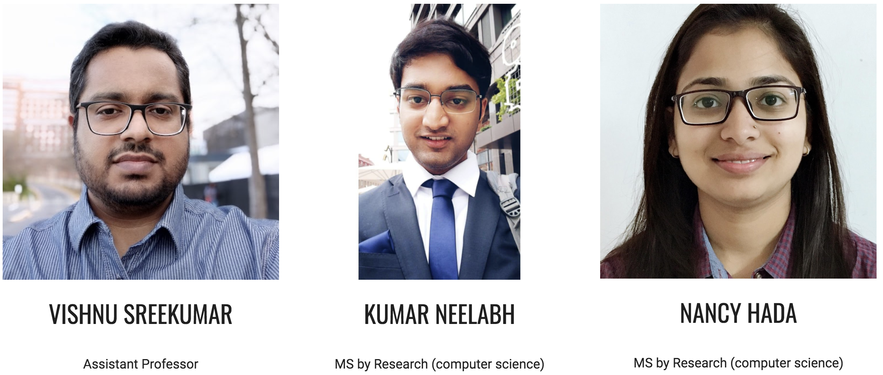

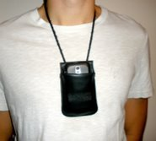
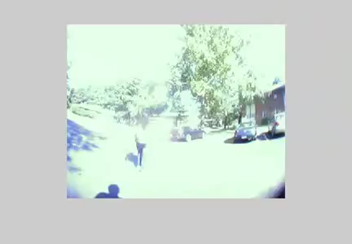
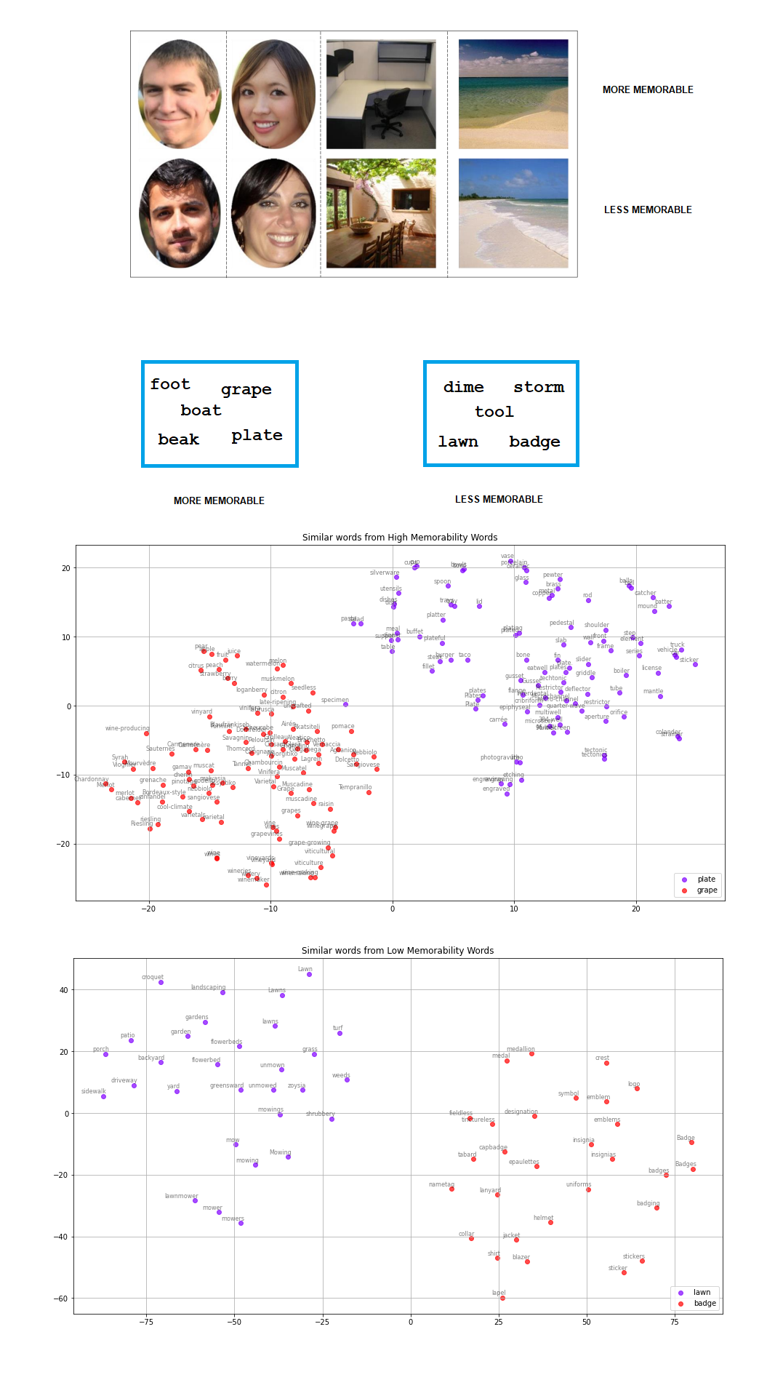
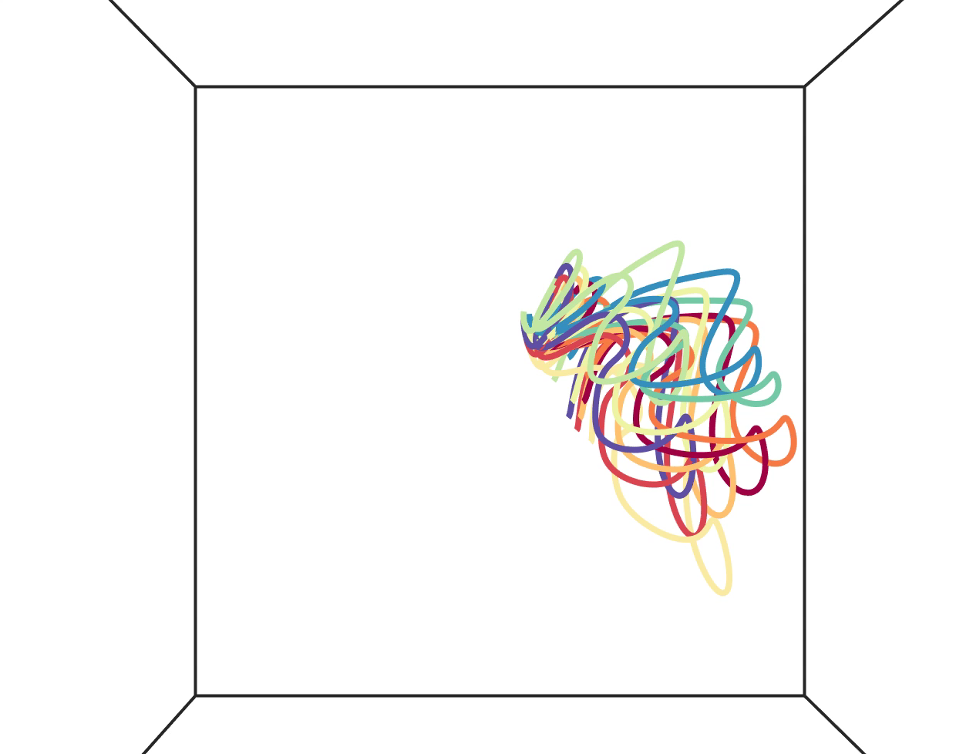
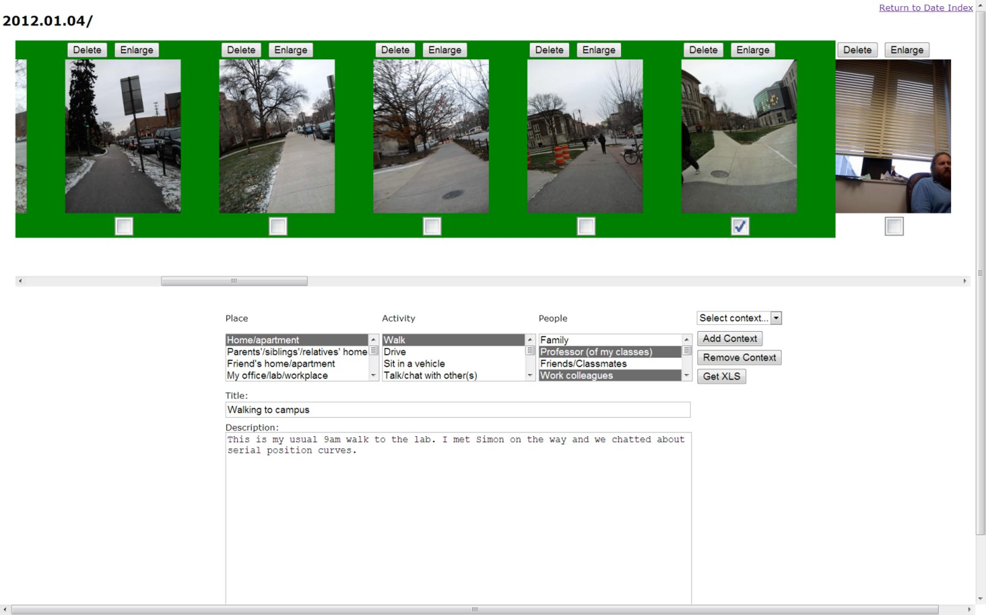
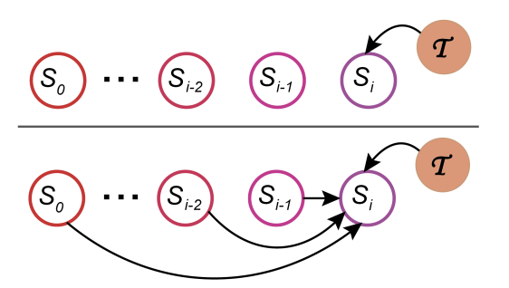
Research Themes
Naturalistic Memory Studies
Language & Memory
Computational Neuroscience
Lifelogging, VR/AR, event segmentation and temporal context experiments with and without EEG.
Memorability of words, sentences, documents
Studying the predictive brain using cleverly designed linguistic stimuli
Using neural language models to understand memory
The role of cortical traveling waves in cognition
Obtaining neural evidence for retrieved context theories of memory
Neural population geometry and dynamics underlying human memory and learning
Sap et al., 2022
Funding: IIITH Start-up Funds
Collaborators: NIH, UChicago (Wilma Bainbridge), and more being established

Slide 7
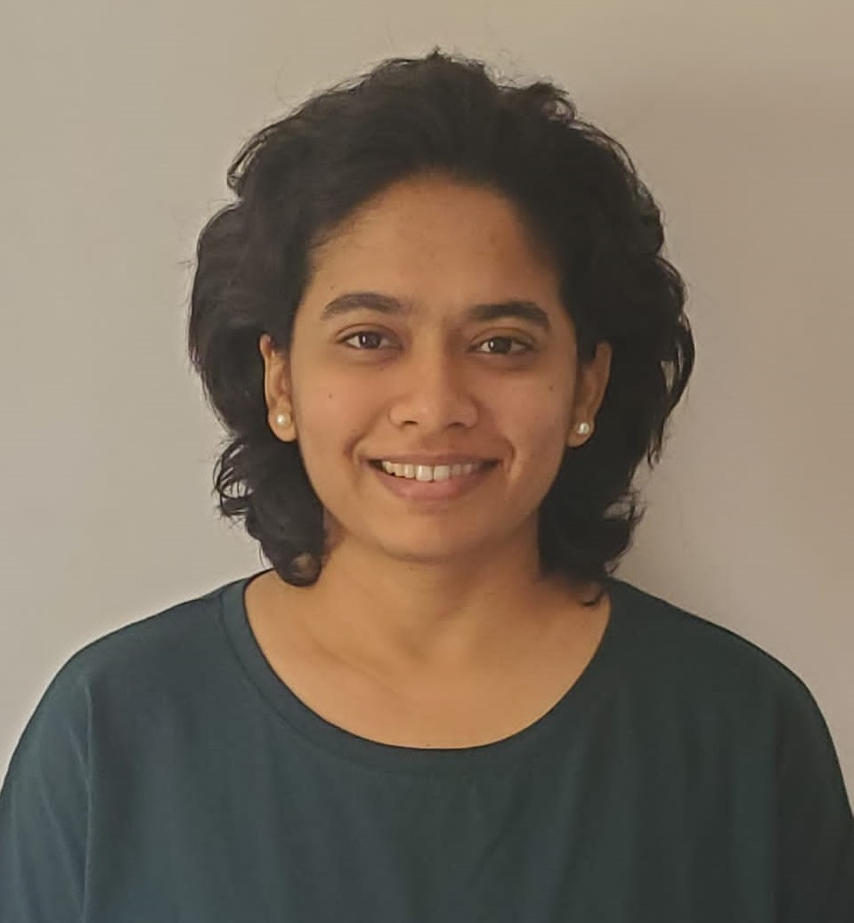
How do stress & depression affect memory processes?
How do long term memories influence decision-making?
Do qualitatively rich experiences help to override effects of stress?
Looking for students who can -
1. Design ingenious behavioural paradigms that can answer the above questions
2. Establish a method of measure chronic stress (behaviour + physiological)
3. Are committed to learning and completing projects.
Bhaktee Dongaonkar
(stress and cognition)

Slide 8
Please contact the individual faculty for more details! Looking forward to interacting with all interested students...
Time perception, AI, computational modelling
Empathy, neurorehab, neuroeconomics, game platforms
CogSci Lab
Bapi Raju
Professor, IIITH
Kavita Vemuri
Assistant Professor
IIITH
Music perception and social media, risk factors for depression
Stress, depression, memory & decision making, cognitive ageing
Memory, Lifelogging/
Extended Reality, Comp-Neurosci
cognitive risks for depression, virtual reality, eye-movement, and gait behaviour
Vinoo Alluri
Assistant Professor
IIITH
Bhaktee Dongaonkar
Assistant Professor
IIITH
Priyanka Srivastava
Senior Research Scientist
IIITH
Vishnu Sreekumar
Assistant Professor
IIITH

